Slide 1

Hexaware CODE&RISE
InnovateX_Crescent's RideShare
InnovateX_Crescent presents their innovative RideShare application - a seamless, user-friendly platform for efficient, cost-effective, and environmentally responsible ride-sharing. This solution connects users for carpooling, reducing commuting costs and traffic congestion while contributing to sustainable mobility.

Slide 2
Team and Application Overview
Team Name
Application Name
InnovateX_Crescent
Rideshare Application
Team Members
Email
Tanush M M
tanushmmofficial@gmail.com
Sirasudeen P
sirasudeenp@gmail.com
Syed Fayaadh S [Inactive]
fayaadhsyed@gmail.com
Gouri Shankar Prusty P [Inactive]
pgourishankarprusty@gmail.com

Slide 3

Introducing the RideShare Solution
1
Seamless User Experience
2
Financial Savings
The RideShare app provides a streamlined and intuitive interface for users to easily connect and coordinate their rides.
By facilitating carpooling, the app helps users save on commuting costs and reduces the individual burden of vehicle ownership.
3
Environmental Sustainability
4
Social Connectivity
The app fosters a sense of community by enabling users to connect and travel together, enhancing social interactions.
The RideShare solution promotes eco-friendly mobility by reducing traffic congestion and emissions through shared rides.

Slide 4

Solution Highlights and Key Features
Intelligent Ride Matching
Fair Pricing Model
The app utilizes advanced algorithms to intelligently match users with compatible ride-sharing partners based on their preferences and travel patterns.
The dynamic pricing model ensures fair and transparent cost allocation, considering factors like distance, time, and occupancy.
Enhanced Safety Features
Eco-Friendly Initiatives
The RideShare app incorporates security measures like user verification, real-time tracking, and emergency response protocols to prioritize the safety of all participants.
The solution promotes sustainable mobility by encouraging the use of fuel-efficient and low-emission vehicles, contributing to a greener commuting ecosystem.

Slide 5

Innovation and Creativity
1
Smart & Intelligent Ride Matching
The RideShare app leverages advanced algorithms and AI-powered matching to seamlessly connect users with compatible ride partners, optimizing for factors like location, schedule, and preferences.
2
Dynamic Pricing
The solution's dynamic pricing model adjusts rates based on real-time factors, ensuring fairness and transparency for both drivers and passengers.
3
Generative AI Integration
The app integrates cutting-edge generative AI technologies to enhance user experience, streamline operations, and continuously improve the platform's capabilities.

Slide 6

Architectural Approach
Frontend
React, Material UI, Google Maps API
Backend
Python (Flask), Express.js, JWT, bcrypt
Database
MongoDB
DevOps
Git, GitHub, Docker, AWS (EC2, S3)
Security
JWT, Hashing (bcrypt)
Testing
Postman

Slide 7
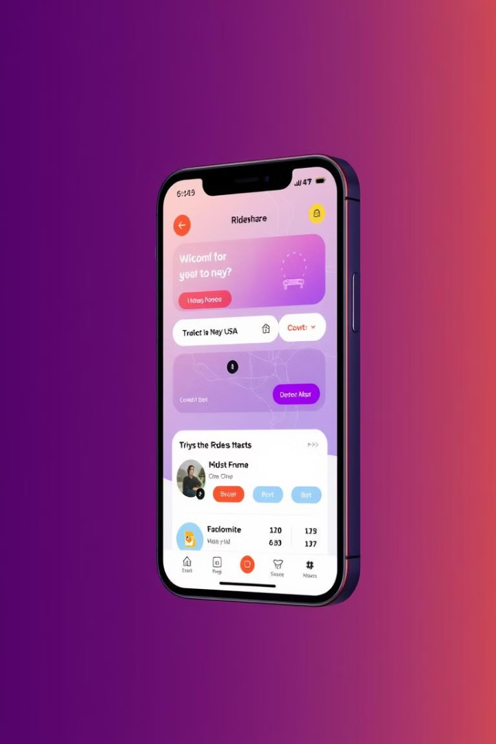



User-Centric Design
Request Ride
Users can easily request a ride based on their location and destination.
Match Rider
The app intelligently matches the user with compatible ride-sharing partners.
Complete Trip
Users can track their ride and provide feedback to improve the experience.

Slide 8
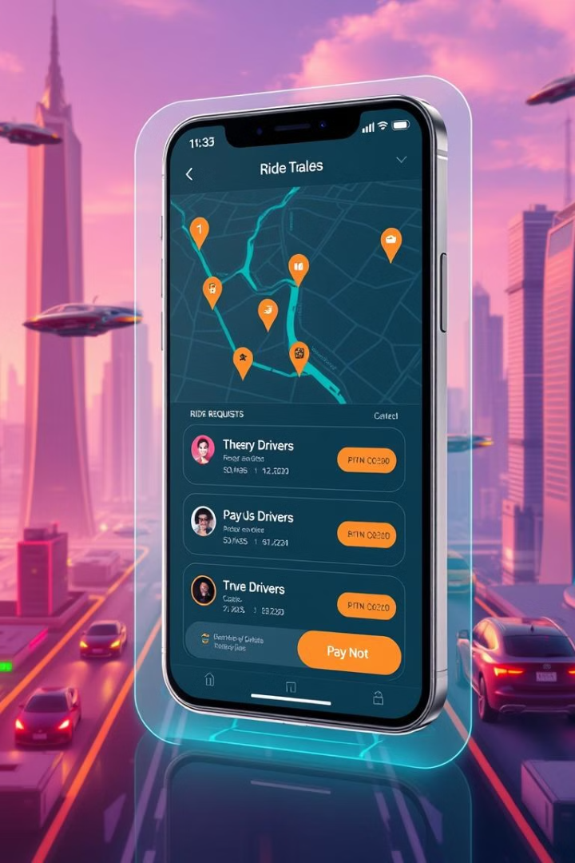
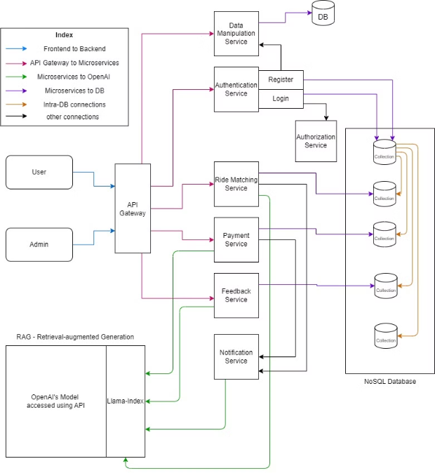
Technical Architecture
The RideShare solution uses a modern tech stack, including Python, Express.js, React, and Material UI. It integrates with Google Maps to provide a scalable, reliable, and high-performing ride-sharing platform.

Slide 9

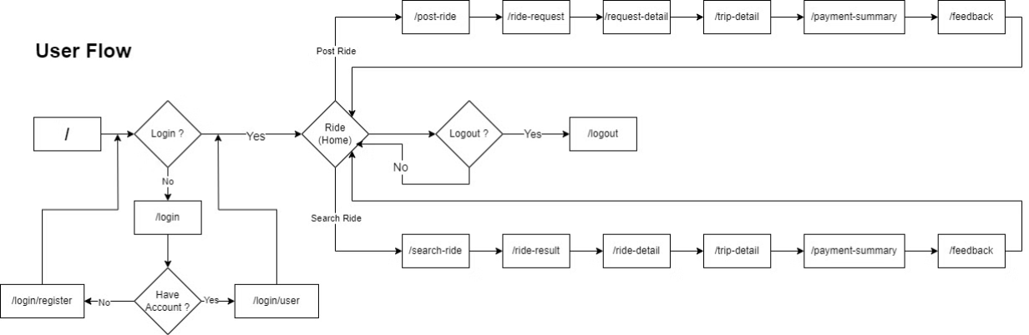
Functional Architecture - User Flow
The RideShare app's architecture supports user and admin needs. Users can request rides, match partners, and track trips. Admins can manage the platform, monitor performance, and ensure smooth operations.

Slide 10

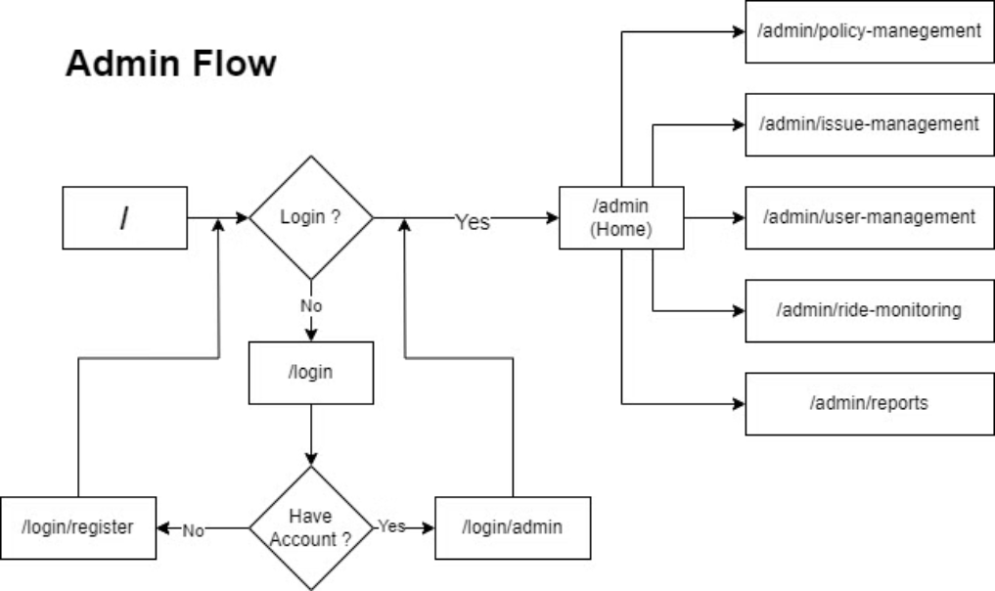
Functional Architecture - Admin Flow
The RideShare admin interface empowers platform oversight. Admins can monitor metrics, troubleshoot issues, and ensure reliable operations. They have tools to manage users, drivers, and fleet records to maintain the ecosystem.

Slide 11
User Interface: Designed for Efficiency, Crafted for Users
Consistency & Simplicity
Accessibility & Usability
Material UI Integration
Our user interface follows a unified design language, with a minimalist aesthetic and predictable navigation, ensuring a seamless and intuitive experience.
RideShare prioritizes accessibility, with high-contrast UI, readable fonts, clear visual cues, and full support for keyboard and screen reader inputs.
By leveraging the power of Material UI, we deliver a responsive, customizable, and pre-built component library, optimizing for both efficiency and user delight.

Slide 12
User Journey: Joining a Ride
Step 1
1
Create an account or log in to find available rides.
2
Step 2
Browse rides using our smart ride-matching algorithms.
Step 3
3
Confirm the ride and receive all necessary notifications.
4
Step 4
Complete the ride, make payment, and leave feedback.
Step 5
5
Repeat the process to discover more convenient rides.

Slide 13
User Journey: Posting a Ride
Step 1
1
Create an account or log in to post a new ride.
2
Step 2
Easily input ride details like destination, time, and seat availability.
Step 3
3
The ride is displayed to relevant users via our intelligent matching algorithms.
4
Step 4
Confirm the riders and receive notifications about the ride status.
Step 5
5
Leave feedback after the ride is complete.

Slide 14

ESG & CSR: Sustainability in Motion
Environmental Responsibility
Social Responsibility
Our platform fosters a sense of community, ensuring fairness, safety, and inclusivity for all users.
RideShare promotes eco-friendly commutes through carpooling, reducing traffic congestion and the environmental impact of urban transportation.
Governance Practices
RideShare upholds the highest standards of ethics, data privacy, and security, reinforcing trust and transparency.

Slide 15

Innovation in Action: RideShare Demo
RideShare is a comprehensive and innovative solution that addresses the challenges of modern urban mobility. By combining efficiency, safety, and sustainability, our platform exemplifies a forward-thinking approach to revolutionizing the way people commute.

Slide 16
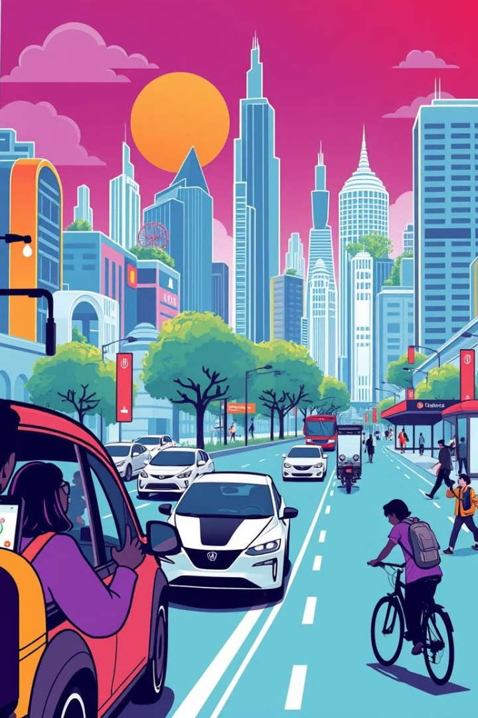
RideShare: Revolutionizing Urban Mobility
1
Smart Ride Matching
2
Dynamic Pricing
Our intelligent algorithms connect riders efficiently and in a timely manner.
We ensure fair and transparent rates for all users.
3
Sustainability Initiatives
4
Scalable Architecture
Our platform promotes carpooling and eco-friendly transportation options.
We leverage modern cloud infrastructure and microservices for high performance and scalability.
InnovateX_Crescent's RideShare solution harnesses the power of technology to create a transformative mobility platform. By prioritizing user experience, sustainability, and innovation, the team has developed a comprehensive and impactful solution that can revolutionize the way people commute and connect in urban environments.

Slide 17


Meet the team
Tanush Modem Mahesh
Sirasudeen P
SKILLS Backend [Flask - Python], Cloud [AWS], Docker, API Testing [Postman], Database [MongoDB], Data Science, Java
SKILLS Frontend - REACT.js, Google Maps API, MaterialUI, Cloud [AWS], CPP

Slide 18

Thank You
Team Name: INNOVATEX_CRESCENT
Team Members
Email
Tanush M M
tanushmmofficial@gmail.com
Sirasudeen P
sirasudeenp@gmail.com
Syed Fayaadh S [Inactive]
fayaadhsyed@gmail.com
Gouri Shankar Prusty P [Inactive]
pgourishankarprusty@gmail.com

Slide 19
Q & A

